Slide 1
Give us Space
Workshop Sep 5 2018
Update from Dory Reeves

Slide 2
NSC11 Give us Space
This project is designed to support better access to and usage of key semi-public spaces.
This access, we hypothesise, has the potential to provide opportunities for social interaction and associated social networks and promote hauora for the local community.
The team will co-create and pilot a data collection tool based on physical and digital (social media) realms/cultural geographies.
The toolset will make use of existing web-based services to provide access to information on resources, condition, use and perception (both historical and in quasi-real time) of key semi-public spaces in three case-study communities of Auckland and Wellington.
This toolset will provide information on the appropriateness of contemporary socio-cultural landscapes. The project will draw on available cultural mapping material documenting the Māori and social histories of each site.

Slide 3
Research Activities
Network event at the World Urban Forum in Kuala Lumpur
Workshops to identify study spaces and the significant facilities within and characteristics of the identified study space - areas: 1) Auckland inner city – where spaces are identified by an inner city neighbourhood group in consultation with the Auckland Council Urban Design Team Māori specialist 2) External metropolitan centres in Auckland (Sylvia Park) and Greater Wellington (Naenae) – where the public realm is dominated by shopping malls.
A synthesised review of over 500 references representing recent research in the area of public open space, neighbouring and the role of public and semi-public space in supporting community wellbeing/hauora including cultural mapping material for the case study areas.
A series of assessments of the case-studies in their urban context using both traditional and experimental methods for spatial analysis.
The creation of a detailed set of tables and related graphs, plots and charts with the data resulting from spatial analysis from the case-studies.
The production of a detailed set of maps of the case-studies to visualise data and information produced with the analysis using GIS and Power View applications.
The creation of a purpose built website that links together different webpages with the content produced by the project and connected to the relevant external resources.
The optimisation of website interfaces with particular attention to mobile devices (with a possible development of a native application) to facilitate ubiquitous access.
The production of an accessible final report.

Slide 4
Deliverables
February 2019:
Optimised data will include:
1) summary of planning and consenting documentation,
2) findings of the spatial analysis and
3) quasi real time visualisation of Instagram data. The toolset will be designed to support residents, community groups, and public and private organisations to use and manage semi-public open spaces.

Slide 5
Deliverables
March 2019:
The web-based pilot toolbox for three case-study areas will include the optimised data tools.
To guarantee functionality, navigability and ease of access to the website’s content, the research process will include various tests and workshops with end-users and stakeholders.
Final report
2 journal articles

Slide 6
Deliverables – Dory’s team
WUF9 – workshop
Synthesis of literature reviews undertaken between 2016-2018
Further literature searches and reviews on gendering spaces; spaces and deprivation
Traditional observation tool to be used to assess spaces
Google map to share information about specific spaces
Archive research for 2
semi- public spaces in
Auckland: Lumley Tower
and Princes Wharf

Slide 7
WUF9 workshop summary of gender and indigenous issues

Slide 8
Indigenous and Gender Workshop at WUF9 Give us Space Network Event
Participants:
Cecilia Andersson, UN-Habitat, UN-Habitat’s Public Space Programme Urban Planning And Design Branch UN-Habitat
Fatemah Roohafza, PhD RMIT
Fatema.roohafza@rmit.edu.au
Huraera Jabeen, BRAC University, Bangladesh
huraera@bracu.ac.bd
Shamimi Shamsuddin, Malayasia
shamimi.shamsuddin@mara.gov.my
Cassie Blair, Professional Programmes Manager, AIA Seattle, US
cassieb@aiaseattle.org
Sriany Ersina, University of Alauddin Makassar, Indonesia
Sriany.ersina@gmail.com
Stephanie Cheung, Project Manager iDiscover City Walks Hong Kong
i-discover@urbandiscovery.asia
Olivia Haddon
Dory Reeves

Slide 9
Indigenous Issues in Semi Public Space
Making visible the invisible - mutual benefit (inclusive accessibility) for all
Recognition of mana/ indigenous sovereign authority through participatory processes as stakeholders and progressing partnership models for indigenous governance
Having regard to Indigenous values and knowledge, sites of significance and traditional names and regeneration of natural resources and natural systems – early engagement.
Work with Maori/indigenous artists and designers through the spatial design process for distinct outcomes

Slide 10
Gender issues in semi public spaces
Equity of access
Access to spaces
Safety and security
Seating
Shade
Access to toilets
Activities in spaces
Participation in design

Slide 11
Summary of Issues Raised
Women think about benefit to others - cultural knowledge comes into play
How can policy makers make public space for women? Religious and cultural beliefs exclude women from public space. With Implications on health and wellbeing
Intergenerational spaces, for carers and different ages and stages
Lack of opportunities for social interaction
Migrants and ethnic minorities as asylum seekers, immigrants, lack of social status no programmes for integration. Utilising public space
Aesthetics of spaces of belonging. How to make Public space that is welcoming to all
Invisibility – indigenous, adolescent girls, designing for safety and participation

Slide 12
Issue Statement
Duty of care to design public space for the invisible
Safe, accessible and participatory processes.
Awareness of politics of power in public space, cultural, religious, political, social and gender dominance.
Indigenous
Adolescent girls
Marginalised
Ethnic minorities
Asylum seekers
Conclusion: Worldwide the marginalised including indigenous people and their issues are invisible, participatory processes to acknowledge their interests in public space are non existent with the exception of sustainable regeneration projects as catalysts for a relationship to occur. e.g. land, resources and river regenerations.

Slide 14
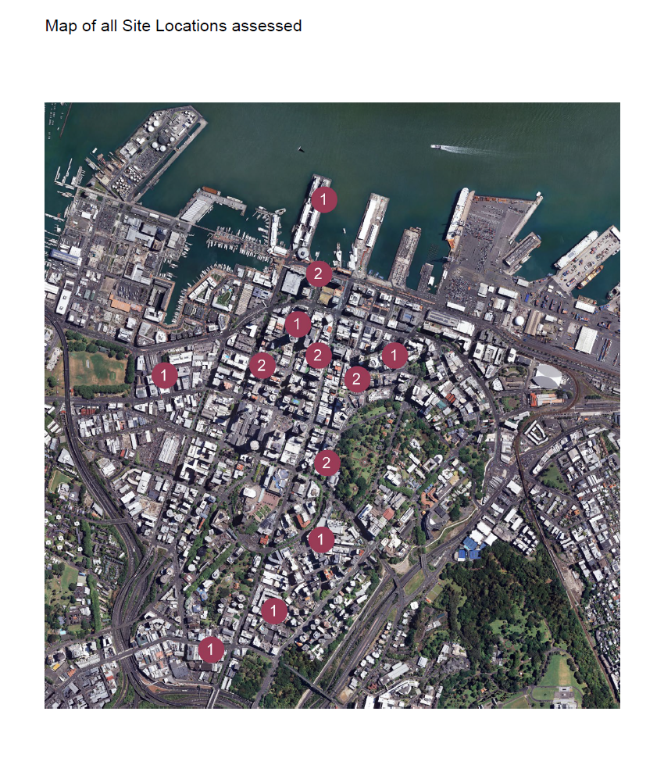
300 page report

Slide 15
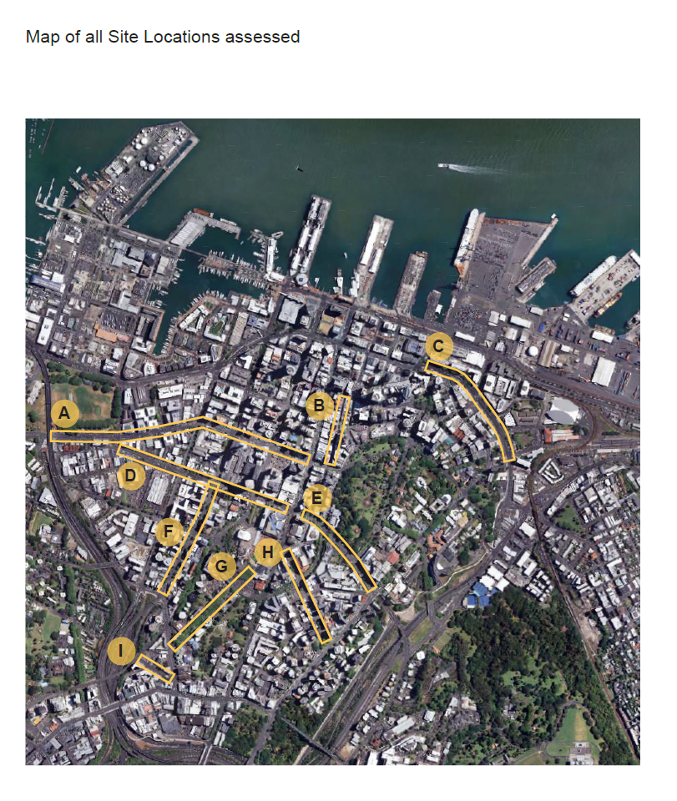
220 page report

Slide 16
Topics identified from the literature reviews in 2017 and 2018 – 23 topics identified
Socio-economic status: gentrification and deprivation
Political participation
Democracy, social movements, justice and activism
Management: control
Ownership: privatisation
Urban growth: change
Resilience
Technology: internet
Human behaviour; perception
Defining evaluating public space
Other
Health well being and sociability
Neighbourhoods and suburbs
Place making and identity
Ecological sustainability
Pedestrian mobility: accessibility
Safety
Density
Age (elderly, youth and children)
Ethnicity: culture
Disability
Gender
Sexuality

Slide 17
Observation tool
Princes Wharf
Queens Wharf
Waitemata Plaza
St Patrick’s Square

Slide 20
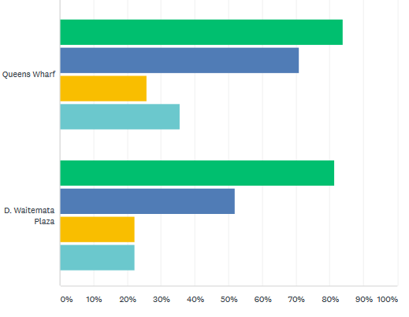
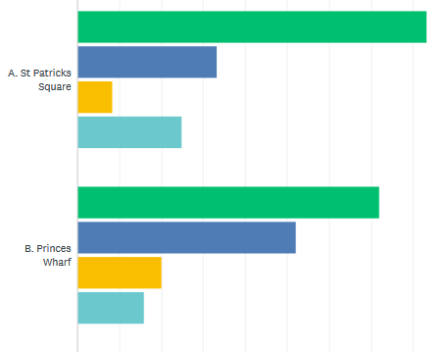
Q10: Tick if you have found social media activity relating to the space and make a separate note about the nature of this activity.
Answered: 31 Skipped: 0

Slide 21
Q7: Tick what visual evidence of Maori cultural landscape is evident

Slide 22
Google map

Slide 23
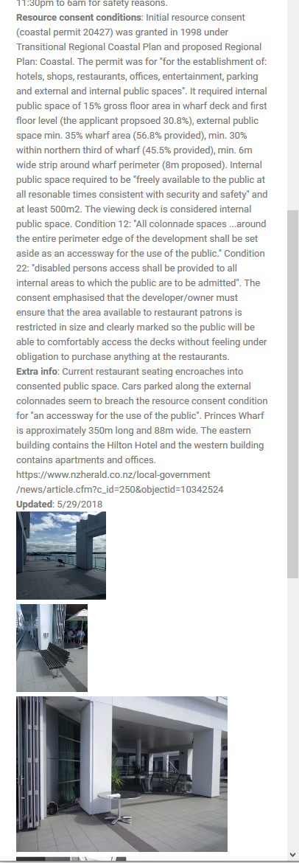

Slide 25
Resource Consent Archive research to look at what rights do the public have.
Lumley Tower
Princes Wharf

Slide 26
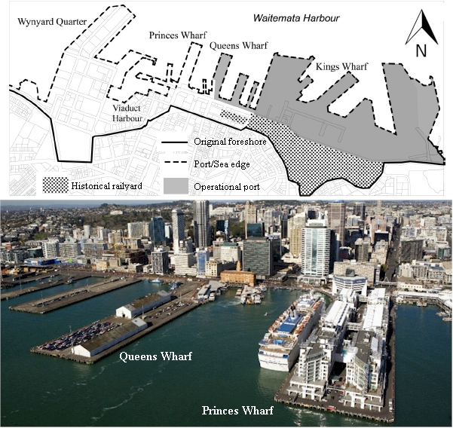
Princes Wharf

Slide 27
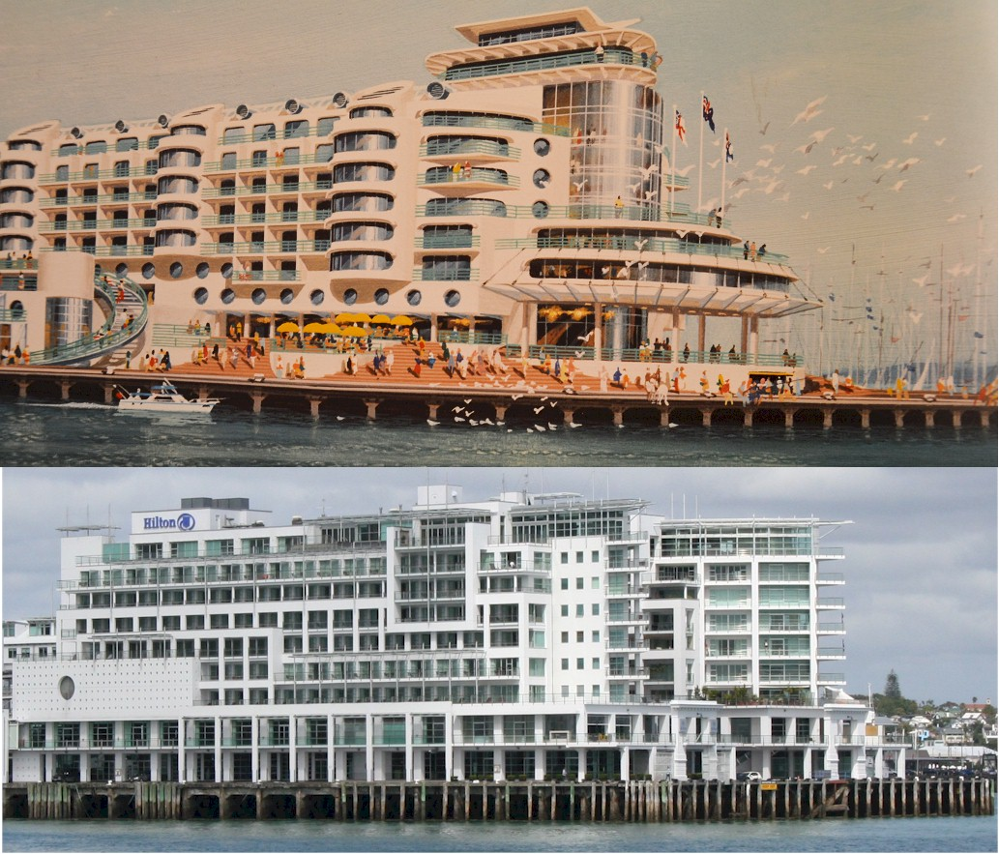
How did we get from this to this

Slide 28
Auckland Library
Archives up on level 2, Lorne Street
Auckland Scrap Book
Newspapers

Slide 29
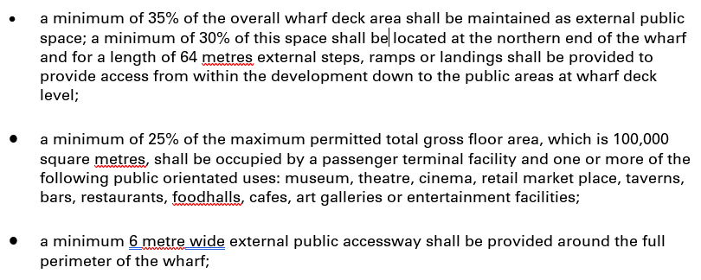
1980’s Objectives for Princes Wharf

Slide 30
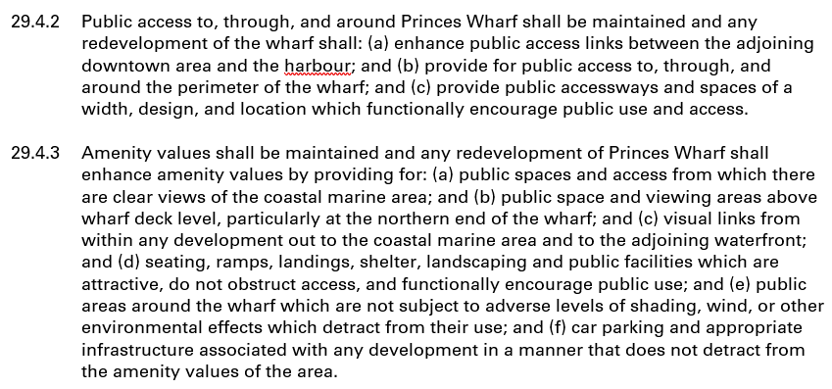
1980’s Objectives for Princes Wharf

Slide 31
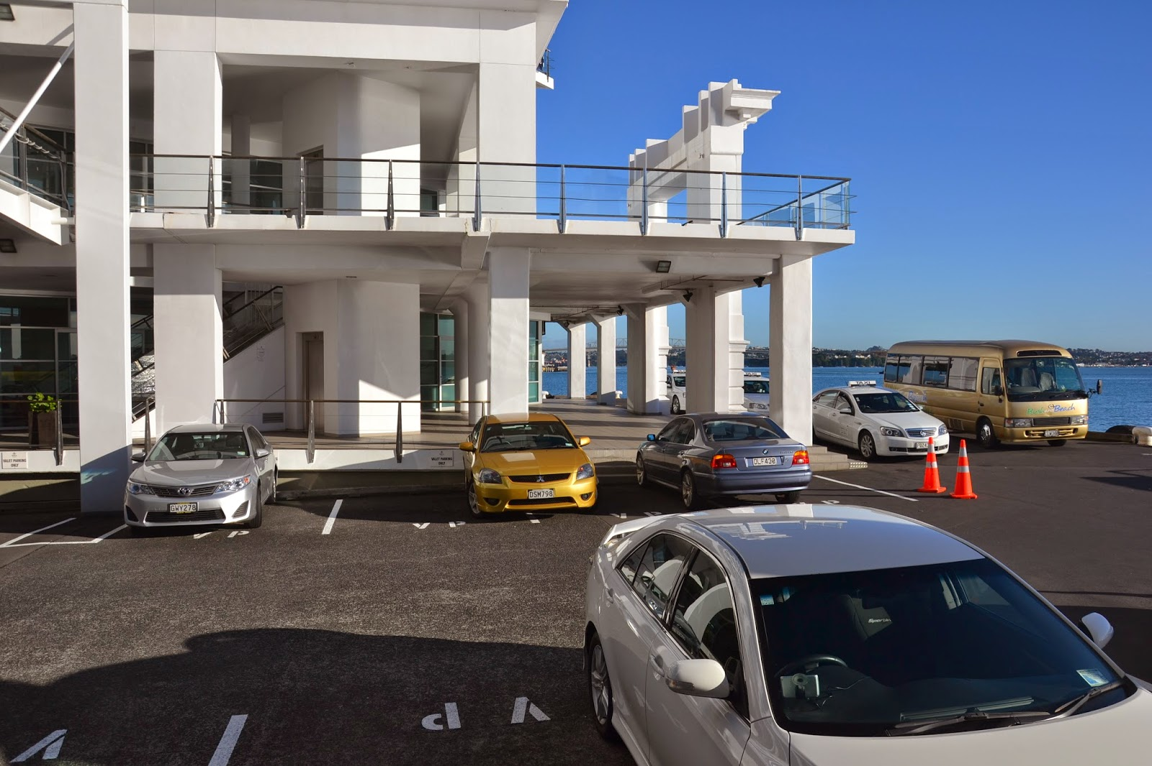
Princes Wharf Public Space

Slide 32
Public space research findings
Document 7. Design and Appearance Certification report from Clinton Bird relating to Kitchener Group application to redevelop most of Princes Wharf. Dated November 1998.

Slide 33
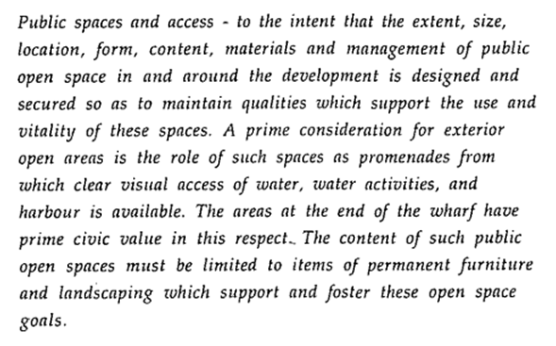
Public space research findings
Document 7. Design and Appearance Certification report from Clinton Bird relating to Kitchener Group application to redevelop most of Princes Wharf. Dated November 1998.

Slide 34
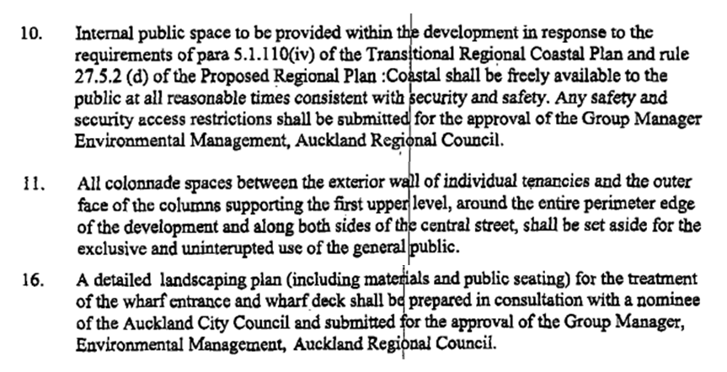
Public space research findings
Document 6. ARC draft conditions of consent for the Princes Wharf development proposal. Dated 12 February 1998.

Slide 35
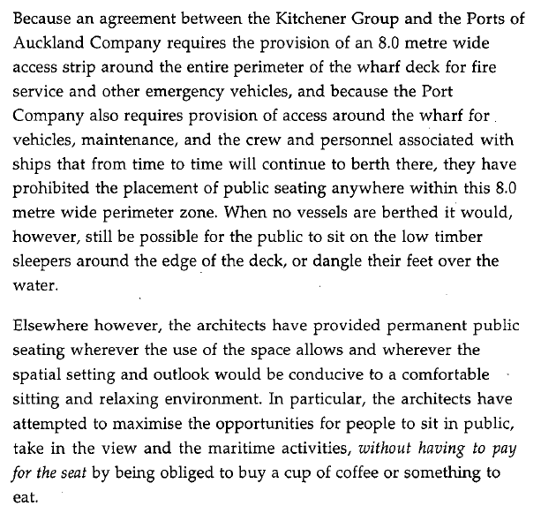
New spanner in the works
Document 8 Page 10. Clinton Bird assessment of redeveloped Princes Wharf landscape plan.

Slide 36
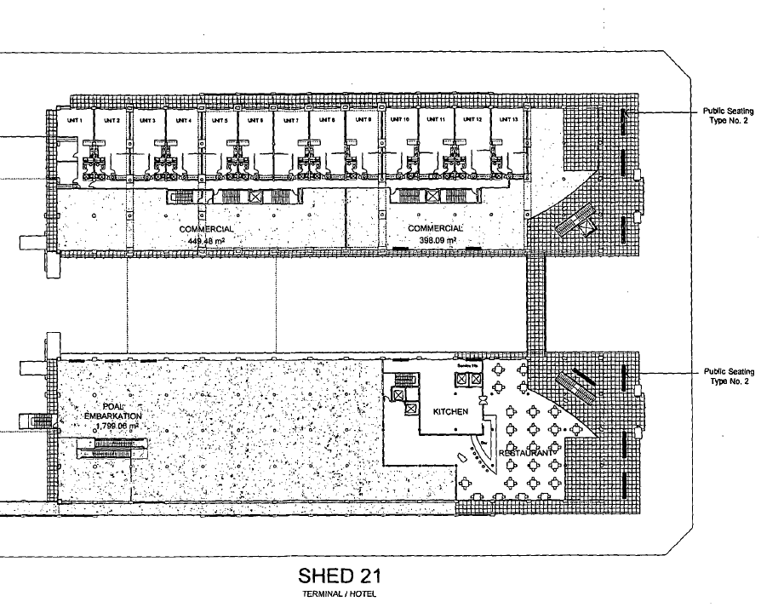
Public space research findings
Figure 4. Proposed level 1 seating plan for northern end of Princes Wharf – after development. Shows seats on public deck. Extract from Document 8.

Slide 37
Conclusions
Planning for public amenity and pedestrian access on Princes Wharf provided for substantial areas when measured in metres.
Despite the best efforts of the architect required to assess implementation, the actual outcomes are disappointing.
Mainly because of the mutually beneficial commercial arrangements between POAL and the developer, and the weak interventions of the main regulator – Auckland Regional Council. Only when the seats had gone, more carparks and vehicular access provided, Hilton largely in control of deck access - did regulator step up.
It is very difficult to reverse incremental changes that limit public amenity and access.

